Slide 1

Categorical Data
Professor Bo Liu
James Watt School of Engineering

Slide 2
Categorical Data
Item of data can be part of a specified set of categories.
  A second handbook could have a condition of “New”, “Like-new”, or “Used”.
Categorical data cannot have multiple assignments within the category
  For an animal cannot be a tiger and a sheep.
Categorical data is extremely common, and frequently using in machine learning applications.
  Commonly sourced from questionnaires.
Boolean data can also be viewed as a form of categorical data.
  e.g., something can be true or false, but not both.

Slide 3
Creating a categorical array
Categorical arrays can be created in MATLAB using the categorical(A) function.
  A is an array like an object that has distinct categories.
  The categories could be numbers or strings.
Example creating a categorical array:
This creates a categorical array of colours
Creating a second categorical array:
colours = ["red"; "blue"; "green"; "red"; "blue"; "green"];
colours = categorical(colours);
shapes = ["square"; "circle"; "triangle"; "square"; "hexagon"; "hexagon"];
shapes = categorical(shapes);
See live script

Slide 4
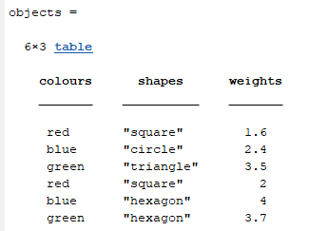
Combining categorical data into tables
Categorical data and none categorical data can be combined together into a table.
weights = [1.6; 2.4; 3.5; 2; 4.0; 3.7];
objects = table(colours, shapes, weights)
See live script

Slide 5
One hot encoding
One way to represent categorical data is via one hot encoding.
The idea behind one hot encoding is to represent the probabilities of a data item belonging to each of the possible discrete categories.
Consider the case where an item that can belong to categories A, B or C
  The one hot encoded representation: [P(A), P(B), P(C)]
One hot encoding steps for data of known categories:
  For data with N distinct categories, create an array of N elements
  Each category corresponds to one index
  Place a 1 at the index corresponding to an items index
  Place a 0 at all other indices

Slide 6
One hot encoding steps
Best understood via an example.
  Considering data where an object could be “red”, “blue”, or “green”
  Create an array of 3 values. The first element corresponds to “red”, the second to “blue”, and the third to “green”.
  For each object we will place “1” in the array at the index that corresponds to the colour, and a “0” everywhere else.
Item | Colour | Red P(Red) | Blue P(Blue) | Green P(Green) | One hot encoded
1 | red | 1 | 0 | 0 | [1, 0, 0]
2 | blue | 0 | 1 | 0 | [0, 1, 0]
3 | green | 0 | 0 | 1 | [0, 0, 1]

Slide 7
One hot encoding in MATLAB
Custom function that takes as an argument a categorical array and outputs a one hot matrix.
function onehotdata = onehotencode(cat_data)
num_items = length(cat_data); % number of items to encode
cats = unique(cat_data); % array of categories
num_cats = length(cats); % number of categories
onehotdata = zeros(num_items, num_cats); % create output array
for i = 1:1:num_items % loop over items
for j = 1:1:num_cats % loop over categories
if cat_data(i) == cats(j) % if item belongs to category
onehotdata(i, j) = 1;
end
end
end
end
MATLAB has this function onehotencode(data, 2) built-in
  It takes an extra input that specifies the dimension along which to encode the data. For 1 dimensional categorical data, this can be 2.
See live script

Slide 8
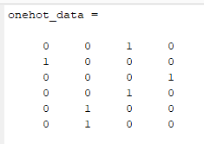
One hot encoding shape data
Going back to the categorical data of shapes from before:
Returned array has 6 rows (objects) and 4 columns (categories).
shapes = ["square"; "circle"; "triangle"; "square"; "hexagon"; "hexagon"];
shapes_cate = categorical(shapes); % convert to categorical array
onehot_data = onehotencode(shapes_cate, 2)
categories
items
See live script

Slide 9
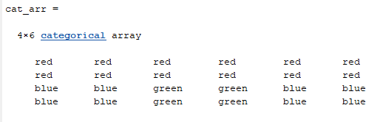
One hot encoding higher dimensional data
Create a 2-dimensional categorical array, with 4 rows and 6 columns.
cat_1 = repmat("red", 2, 6) % 2 row 6 column matrix of “red”
cat_2= repmat("blue", 2, 2) % 2 by 2 matrix of “blue”
cat_3 = repmat("green", 2, 2) % 2 by 2 matrix of “green”
cat_arr = categorical([cat_1 ; cat_2, cat_3, cat_2]);
See live script

Slide 10
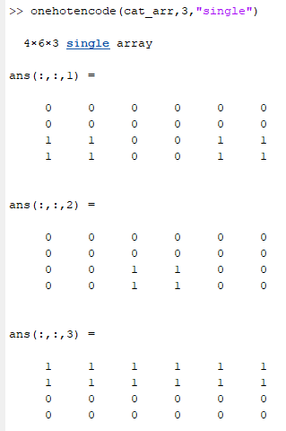
One hot encoding higher dimensional data
One hot encoding this array:
onehotencode(cat_arr, 3)
Because data is now 2 dimensional, then the final argument should be at least 3.
blue
Array has dimensions: 4, 6, 3.
green
red
See live script

Slide 11
One hot encoding purpose
One hot encoding is used because it can represent the probability of an item belonging to a category
  The entries for each object do not need to be 1, and the sum of them is 1.
For instance, for a given picture of an animal, a machine learning model could predict the probabilities of the animal’s species.
  E.g., [0.25, 0.25, 0.25, 0.25], would mean that there is an equal probability of an item belonging to 4 different categories.
If we know the true species of the animal, then we can compare the predicted probabilities to the real probabilities.
  This allows us to ascertain how good a machine learning model is performing.

Slide 12




Thanks!
#UofGWorldChangers
@UofGlasgow

